Slide 1

Comp 20 Web Programming
Relational Database

Slide 2
What is a database?
… an organized collection of data, generally stored and accessed electronically from a computer system. (Wikipedia)
Two popular database technologies today:
RDBMS/SQL
MySQL, Oracle
NoSQL
Mongo, Couchbase

Slide 3
rdbms NOSQL (not only sql)
Entities are placed in separate units called tables
Reduction of redundancy
Optimized for size and efficiency of data
Query using SQL
Originated in 1998
Better for massive amount of data
No schema
No tables (documents)
Key value pairs
No query language

Slide 4
Relational Datbases

Slide 5
Relational Database Model
Tables have columns and rows (records)
Relational Database
columns
Procedures
Tables
Views
id | name | email
rows
Rows (records)
Columns(fields)
Columns have a name and a data type

Slide 6
Primary Key – Foreign Key Relationships
primary key
foreign key
id | dept_id | first_name | last_name
101 | 10 | Jenny | Smith
102 | 4 | Jamie | Dugan
employee
primary key
id | name
10 | Sales
4 | Marketing
department
The tables are related via id/dept_id

Slide 7
One to Many
There are three possible relationships between two entities:
1 to 1
There is one item in entity A that matches one item in entity B- not useful
1 to Many
1 item in entity A relates to several items in entity B
Many to Many
Many items in entity A relate to many items in entity B
Books
Authors
∞ 1
Classes
Students
∞ ∞

Slide 8
Assignment Tables
Many to many relationships are not permitted in a relational database.
In order to make this work, add a third table as an association or assignment table
The assignment table sits between the other two creating two sets of 1-many relationships.
Books
1 ∞
Books_Authors
Authors
∞ 1

Slide 9
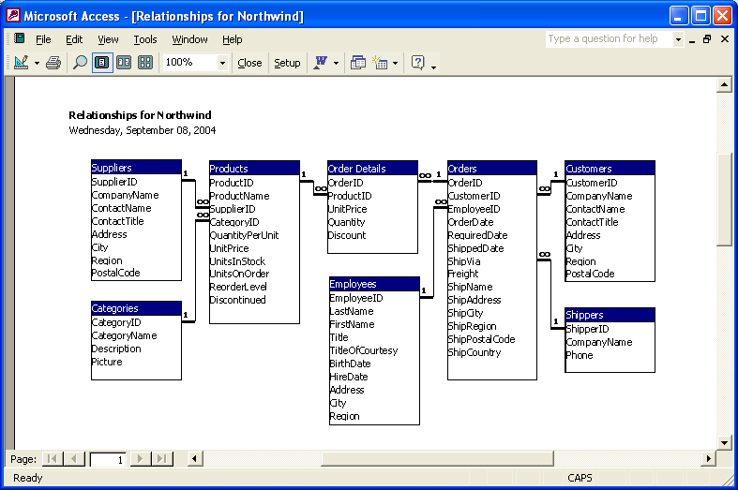
Example : Northwind ERD (entity relationship diagram)

Slide 10
SQL: Structured query language
Data retrieval
Set up structure of the data
Insert data
Roles and permissions
Practice: https://www.w3schools.com/sql/trysql.asp?filename=trysql_op_in

Slide 11
The SELECT Statement
Creates database queries
No special formatting rules
Case insensitive
Can involve one or more tables
Table prefixes – must be used when there is ambiguity. Otherwise, they are optional
categories vs. northwind.categories
SELECT fields
FROM tables
WHERE conditions
ON join multiple tables
GROUP BY columns
HAVING grouping criteria
ORDER BY columns

Slide 12
Filtering Columns
The SELECT statement can be used to display data from one or more columns.
Use * as a wildcard to indicate all columns
Separate columns with a comma
The clause ORDER BY specifies the sort column
select * from table1 show all columns
select col1 from table1 show column1 only
select col1, col2 from table1 show column1 and column2 only

Slide 13
The where clause
select lastname, region
from employees
lastname region
Davolio WA
Fuller WA
Leverling WA
Peacock WA
Buchanan
Suyama
King
Callahan WA
Dodsworth
select lastname, region
from employees
where region=‘WA’
lastname region
Davolio WA
Fuller WA
Leverling WA
Peacock WA
Callahan WA
Try it: Get all product names and their price

Slide 14
Logical & Comparison Operators use with where clause
= equals
<> not equals
< less than
> greater than
<= less than or equal
>= greater than or equal
select * from table1 where col = 4
Sometimes you will want to apply two or more criteria
In this case use OR or AND to combine logical comparisons
where abc < 10 or def =‘x’

Slide 15
distinct
The DISTINCT modifier limits the results to unique values
select distinct city from employees
List all countries in which there are suppliers – no repeats
How could this be useful?

Slide 16
Special clauses
Checking for Values in a Range
Use BETWEEN clause
WHERE salary BETWEEN 10 AND 20
WHERE salary NOT BETWEEN 10 AND 20
Checking for Missing Values - IS NULL
select * from employees where region is null
IN clause
Allows multiple values for value criteria
WHERE state IN (‘ma’, ‘ct’, ‘vt’, ‘me’)

Slide 17
Working with Dates
To reference a date, use quotes select lastName, birthdate from employees where birthdate= ‘1948-12-11’
Date functions: month(), day(), year() select lastName, birthdate from employees where year(birthdate)= 1948

Slide 18
LIKE clause
Allows criteria similar to regular expression
% any number of chars
_ any single char
Example: Get employees whose last names begin with “D” select lastname from employees where lastname like ‘d%’

Slide 19
Working with multiple tables: Joins
Example: Show all products and the company name of the supplier for all products that cost less than $10
select productname, companyname
FROM products INNER JOIN suppliers
ON products.supplierid = suppliers.supplierid
where unitprice < 10

Slide 20
INNER JOIN syntax
Show all products and the company name of the supplier for all products that cost less than $10
select productname, companyname
FROM products INNER JOIN suppliers
ON products.supplierid = suppliers.supplierid
where unitprice < 10
Show all products from Tokyo Traders

